Slide 1
Pi Pico OOP Mini Project
Ben Jones
Tempe High School
Lecture 1

Slide 2
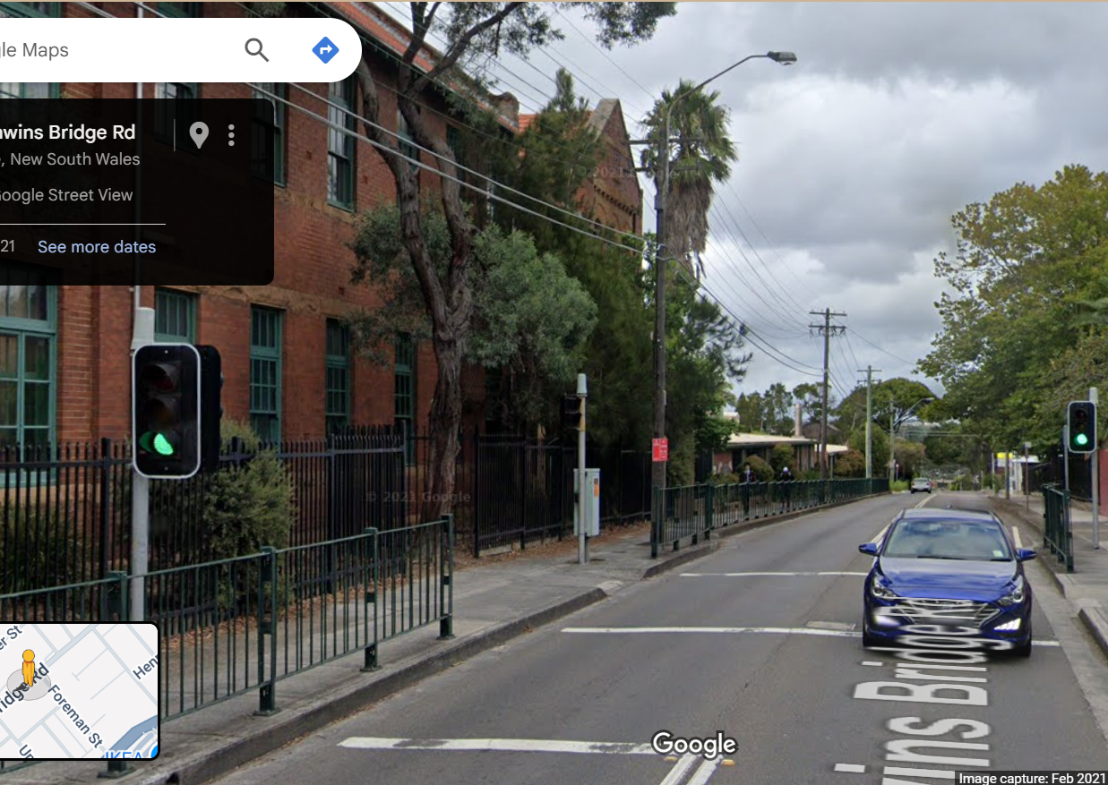
Simple Open Loop Control System
Traffic Lights remain green until pressed (idle state).
Button pressed triggers state change.
Lights rotate through a pattern based on time.
System returns to idle state

Slide 3
Today
Unit Testing
Generalisation
Parent/Child Class
Pin & PWM Parent Classes
Instantiation
Inheritance

Slide 4
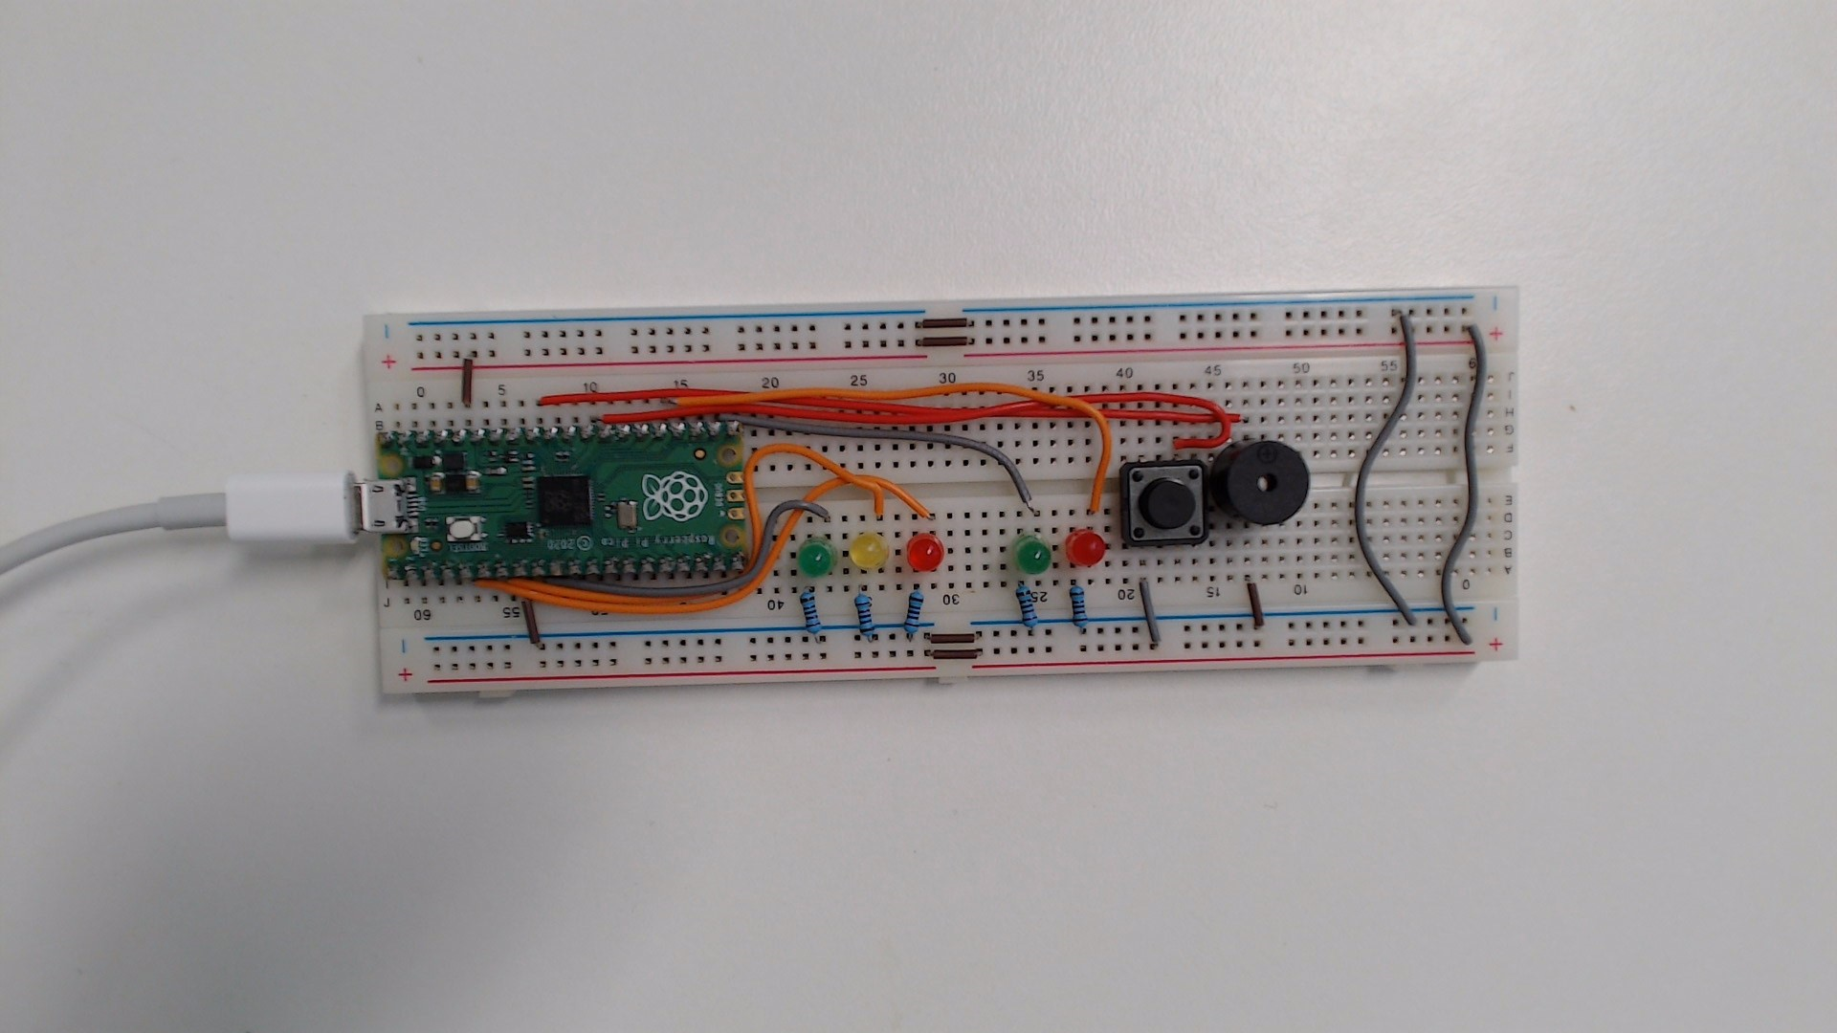
Unit Testing
Testing method where individual components are tested in isolation to verify their correctness.
By ensuring each component works independently, you can build more complex mechatronic solutions.
Logic
Functions
Classes
Components
Controller
Wires
Wiring

Slide 5
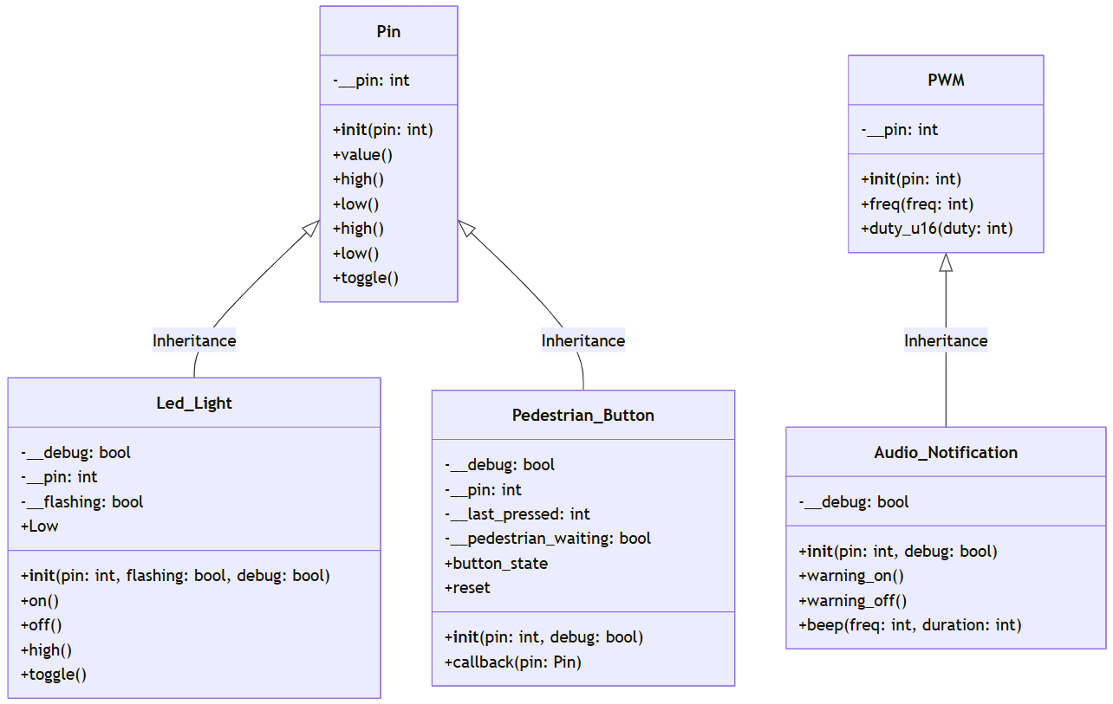
Generalisation
On the Pi Pico, the Pin and PWM libraries are designed to be generalised to provide flexible and reusable interfaces for interacting with the microcontroller’s hardware. The simple on(), off() or high(), low() methods are not specific to any hardware but are generalised to the nature of a digital GPIO Pin. As a generalised class is inherited and the classes are extended, they become more specific (less generalised) and functional to specific hardware for which they are designed.

Slide 6
Parent/Child Class
The parent/susper classes Pin & PWM are more generalised they defines common attributes and methods for their simplest form. The child/sub class inherits the generalised parent/super class and extendeds them poviding more specific (less generalised) functionality for the specific hardware. A child/sub class may add methods and attributes or override them using polymorphism.

Slide 7
Parent Class Documentation
Machine.Pin Library Documentation
Machine.Pin Library Documentation
The Pin library in MicroPython for the Pi Pico allows you to control the General Purpose Input/Output (GPIO) pins of the Pico. It allows you to configure pins as digital (binary) inputs or outputs.
The PWM Library provides an interface for controlling PWM signals on a specified GPIO pin. It allows you to configure any GPIO pin as a PWM and set the duty cycle and frequency.

Slide 8
Instantiation
A class is like a blueprint for an object—it defines the attributes and methods the object will have, but it isn’t an actual object itself. Instantiation is the process of using the class to create a real, usable object in memory.
Run: v03.py

Slide 9
Inheritance
In this case, the Led_Light class inherits from the Pin class, and without any further instructions, the subclass inherits and can call all the methods of the superclass, including on(), off(), high(), low(), toggle(), etc.
Inheritance is a fundamental concept in object-oriented programming (OOP). It allows a class (called a child or subclass) to inherit properties and behaviours (methods and attributes) from another class (called a parent or superclass).
In this case, the Led_Light class inherits the Pin class, and without any further instructions, the subclass inherits and can call all the methods of the super class, including on(), off(), high(), low(), toggle(), etc.
Run: v04.py

